Slide 1

Healthcare(Disease Prediction)
Project Team
Jenna Johnshoy-Aarestad
Campbell Thomas
Deepika
Suhasini Varma

Slide 2
Project Objective
This project leverages datasets sourced from Kaggle. The goal is to construct a predictive model capable of accurately forecasting diseases based on a range of symptoms. Additionally, the project entails the creation of an interactive tool designed to facilitate user input of symptoms, yielding instantaneous disease predictions.
Notes:
Campbell

Slide 3
Project Details
Data Acquisition
Utilize datasets from Kaggle to assemble a comprehensive repository of disease-related information, encompassing symptoms and associated diseases.
Database
Dataset was loaded to SQLite database
Model Development:
Employed machine learning techniques(Random Forest, Decision Tree, Logistic Regression) to develop a predictive model to accurately identifying diseases based on symptom inputs
Evaluation and Validation:
Assess the performance of the predictive model through rigorous testing and validation procedures.
Interactive Tool Creation:
Design a user-friendly tool that enables individuals to input their symptoms to generate predictions regarding potential diseases.
Deployment:
Interactive tool accessible to users, facilitating easy and convenient disease prediction based on symptoms.
Notes:
Campbell

Slide 4
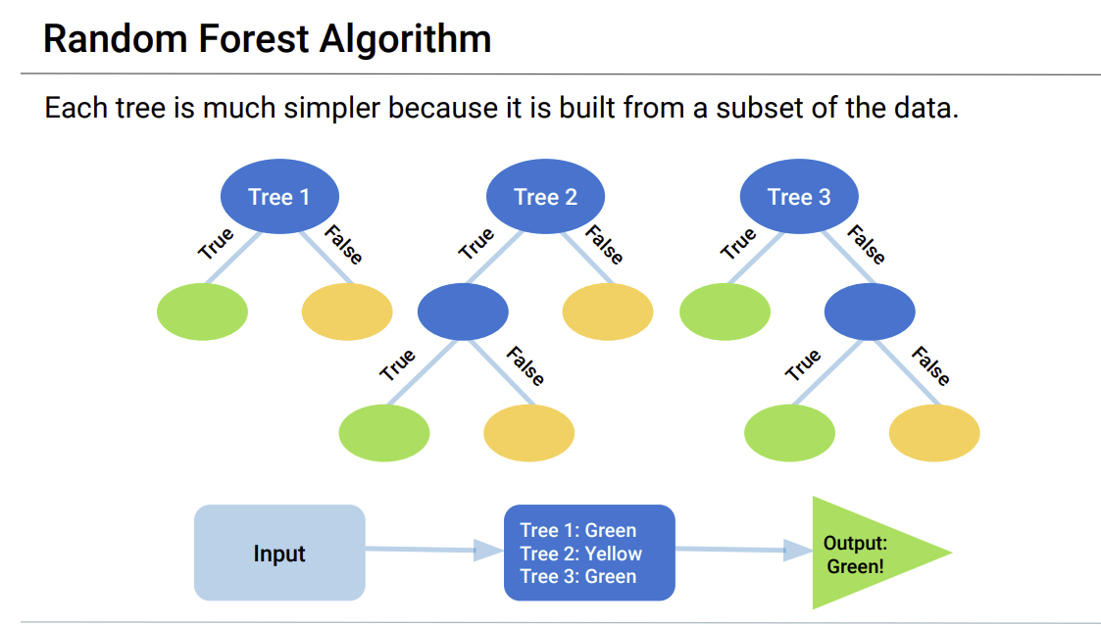
Random Forest Algorithm
A random forest algorithm is a supervised machine learning algorithm that is extremely popular and is used for Classification and Regression problems in Machine Learning. We create these simple trees by randomly sampling the data and creating a decision tree for only that small portion of data. Each simple tree is a weak classifier because it is only trained on a small piece of the original data. Accuracy score of our model was 100%.
Notes:
Jenna – To develop the random forest model, I first explored the data and noticed there were many null values in the symptom columns. So when I went to use the label encoder I added a line in the if statement that fills all of the NAs with "unknown". Getting this working took a couple of iterations. I had first filled with 0, but the encoder didn't like the mix of string and integers within columns. When I fixed that the encoder ran well. Once all of the symptoms were encoded I pre-processed the data into training and testing datasets. I then used the standard scaler to scale the x training data and the x test data.

Slide 5
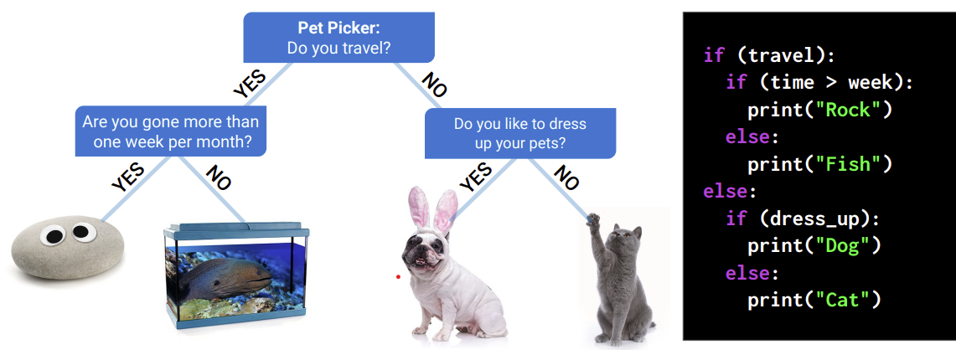
Decision Tree Algorithm
A decision tree algorithm is a machine learning algorithm that uses a decision tree to make predictions. It follows a tree-like model of decisions and their possible consequences. Accuracy score of our model was 100%.
Notes:
Suhasini

Slide 6
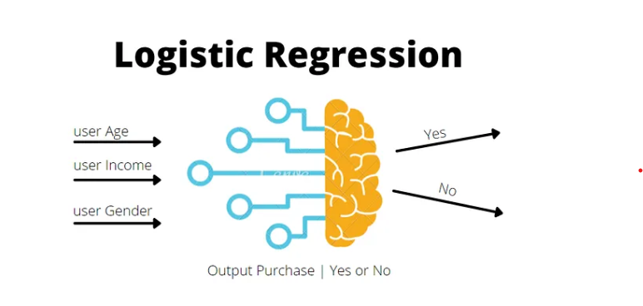
Logistic regression is a supervised machine learning algorithm that accomplishes binary classification tasks by predicting the probability of an outcome, event or observation, The model delivers a binary outcome yes/no, 0/1 or true/false. Accuracy score of our model was 92%.
Logistic Regression
Notes:
Suhasini

Slide 7

Disease Symptom Checker
Disease symptom checker tool allows users to input their symptoms and provides suggestions for possible diseases along with remedies. The app also includes options for selecting gender and age range.
http://192.168.0.11:8501/
Notes:
Deepika

Slide 8

Notes:
Deepika

